Slide 1
Navmeshes And Navigation Graph
More on Pathfinding

Slide 2
What Are They?
For A* to work we need the search graph
Must correspond to navigable areas of level
Could use graphics data
But very large number of polygons
Means A* pathfinding would be very slow
Better to have a separate data set
Based on level data
Usually embedded into level data

Slide 3
Difference Between Navmesh & Navigation Graph
Can either be a set of nodes representing path
Navigation graph
List of connected waypoints
Connections must be navigable
Or set of polygons representing navigable areas
Navmesh
Polygons covering navigable areas of map
Don’t need same level of detail as graphics
Can steer from polygon to polygon

Slide 4
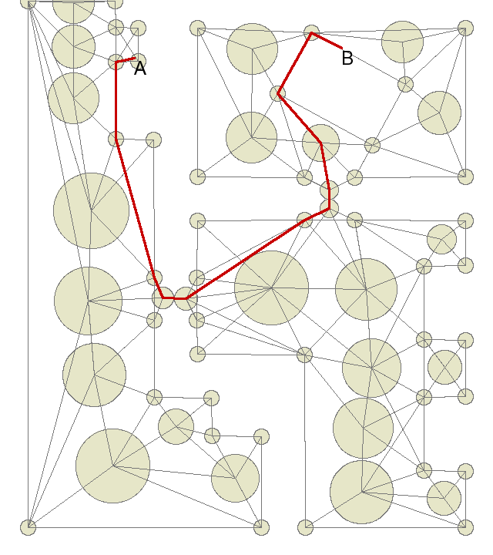
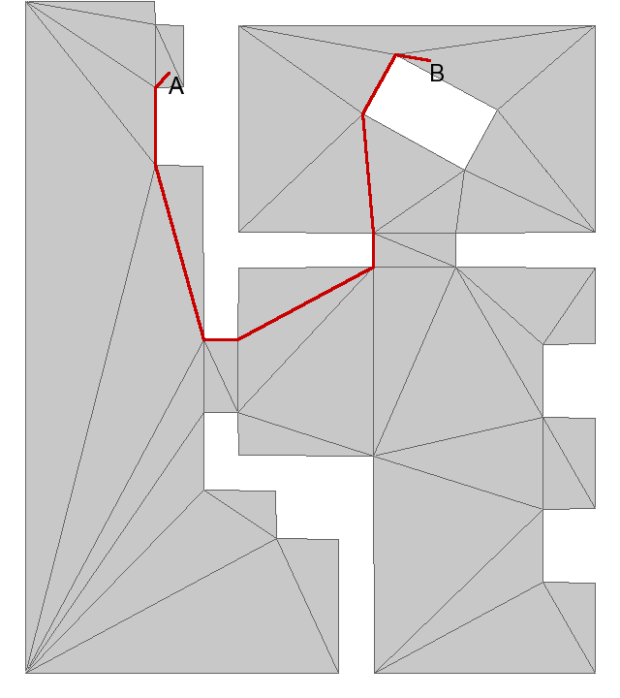
Example
Navigation Graph
Navmesh

Slide 5
How Do We Create Them
Can be added by hand
Slow and painful
Often done by art team
But reliable
Few errors
Or baked in
Automatically generated
Usually during level design stage
Relatively fast
Not real time though
Not reliable
Has to be cleaned up by hand
Can be time consuming

Slide 6
Navigation Graph
Graph nodes scattered around navigable surfaces
Nodes can be any 2D primitive
Quad
Circle etc.
Set of connected waypoints
Nodes can have cost attached
Pathfinder moves directly between points
Nodes can have larger or smaller size
Any path within a node considered valid

Slide 7
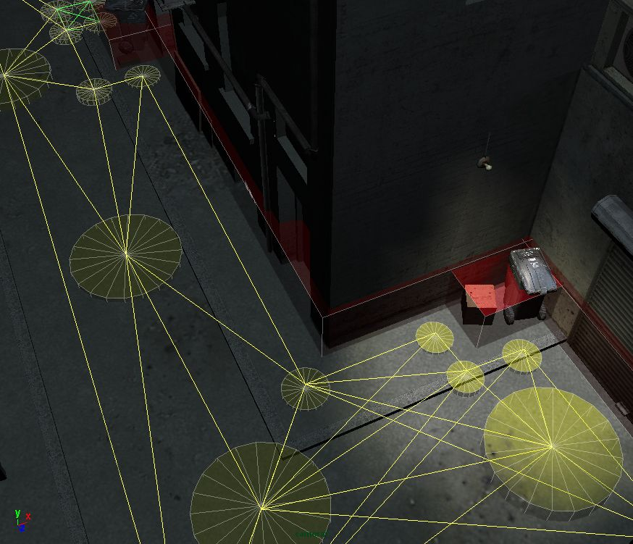
Example
Part of game level showing navigation graph
Note different sizes of nodes
Also note multiple paths between nodes

Slide 8
Navmesh
Convex polygons
Must be convex to prevent steering getting stuck between nodes
Cover all navigable surfaces
Can have cost associated with each polygon
Used for A* heuristic
Try to minimise number of polygons

Slide 9
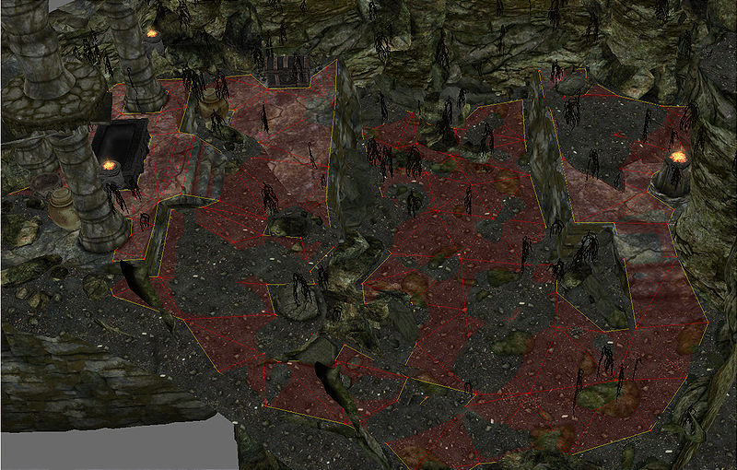
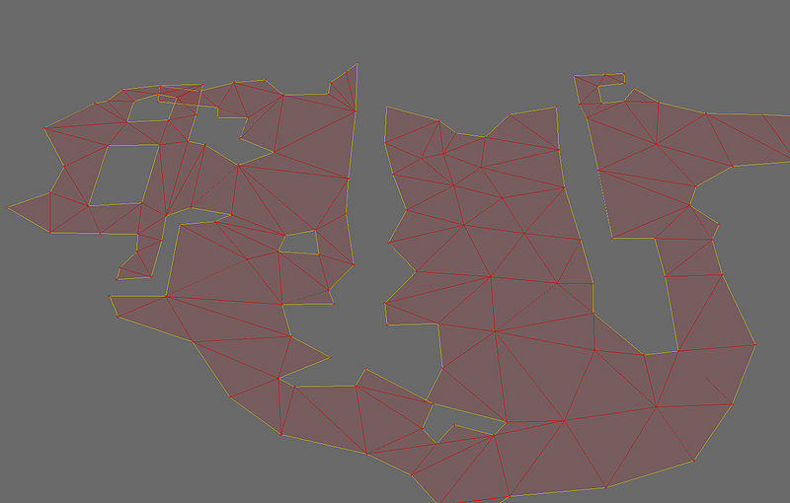
Example
Navmesh with level data
Same navmesh without level

Slide 10
Using The Navmesh
Once navmesh is generated the AI can use it
AI can follow the vertexes of the polygons
Steering algorithms can be used between vertices

Slide 11
Efficiency Issues
Smaller the graph, the faster pathfinding is
Also, smaller graph has smaller memory footprint
Optimising navmesh or graph can reduce number of nodes significantly
Don’t need many nodes in large spaces
Can just steer across space between nodes
Results in inflexible paths of navigation graph
Navmeshes usually more efficient as fewer nodes needed
Agent can steer across entire polygon

Slide 12
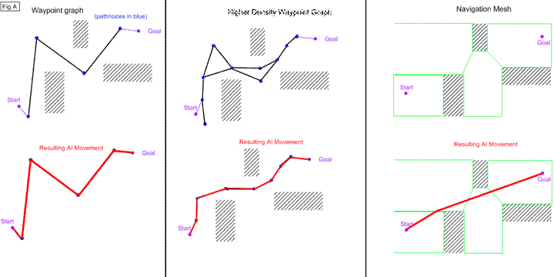
Comparison

Slide 13
Additional
Preprocessing or baking information into the world is a very useful technique
Used for lighting
Shadows
Navigation
Can also aid AI in other ways
Objects in the world can be tagged
This provides information to the AI about the world

Slide 14
Tagged Objects
While on the subject of pre-processing AI data
Tagged objects a useful technique
Add semantic information to objects
E.g. if this object is a chair, label it as a chair
AI can use this information
To decide what action to take
Called affordances. Objects in the world providing information about their use

Slide 15
Tag Information
Tagged objects can have complex information attached
A noun representing objects name
E.g. ‘chair’
Adjectives can describe properties
E.g. ‘comfortable’
Affordances describe actions which can be performed on the object
E.g. ‘run sit animation’
This allows the AI to make decisions about and act on objects in the world

Slide 16
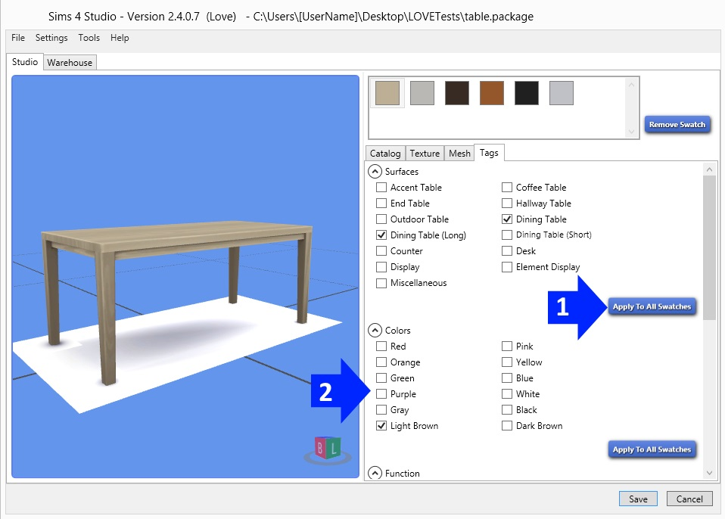
Example (From the Sims)

